Slide 1
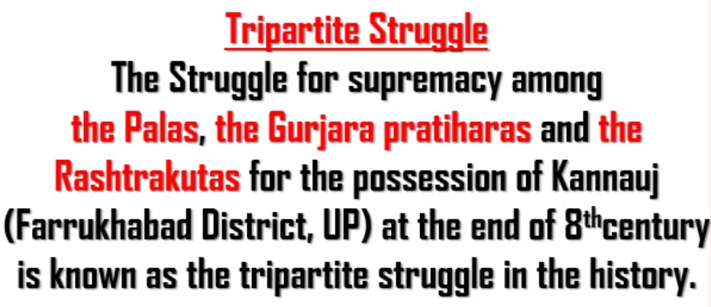

Slide 2
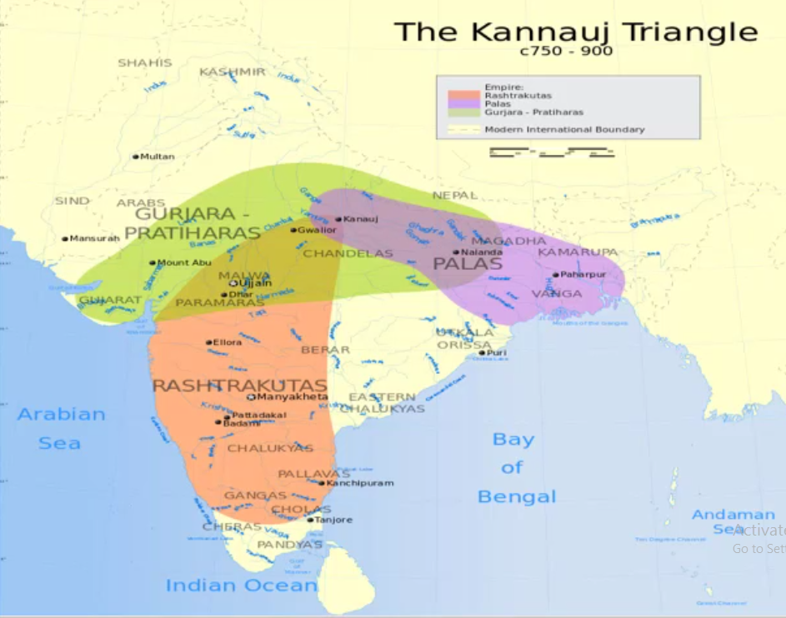

Slide 3
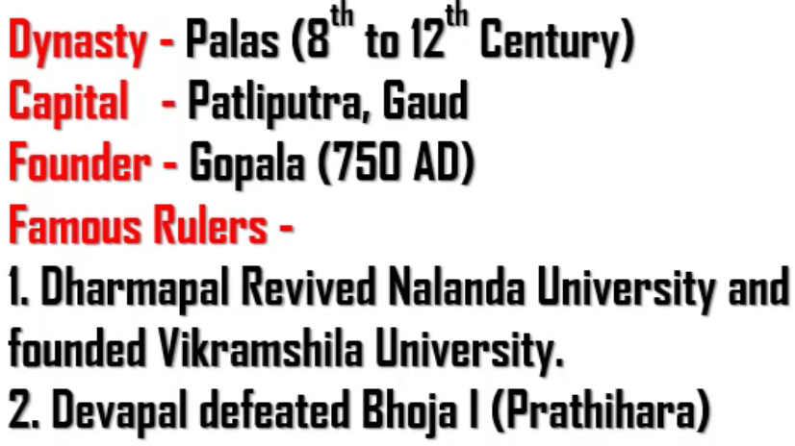
Gopala
Dharmapal
Devapal
Bhoja 1 was a Prathihara ruler.

Slide 4
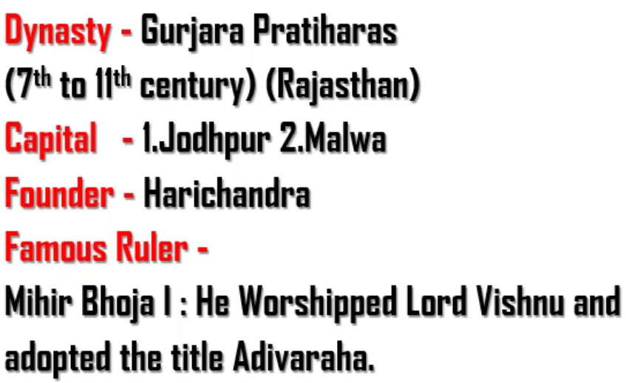

Slide 5
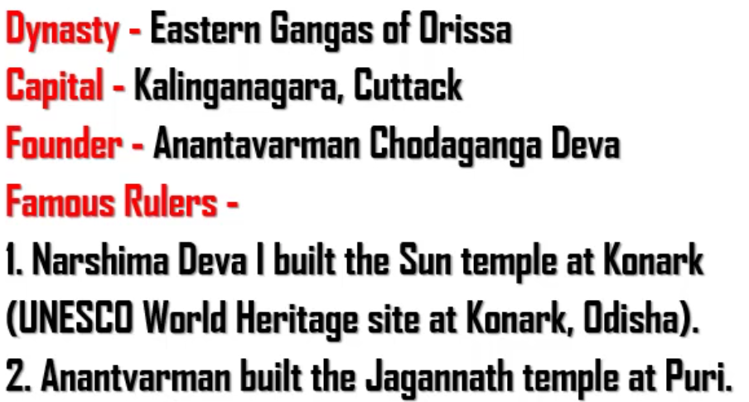
Puri is in Odisha
Remember :
Ashoka defeated Kalinga in the 8th year of his rule
Narshima Deva I – Sun temple at Konark, Odisha
Anantavarman – Jaganath temple at Puri, Odisha

Slide 6
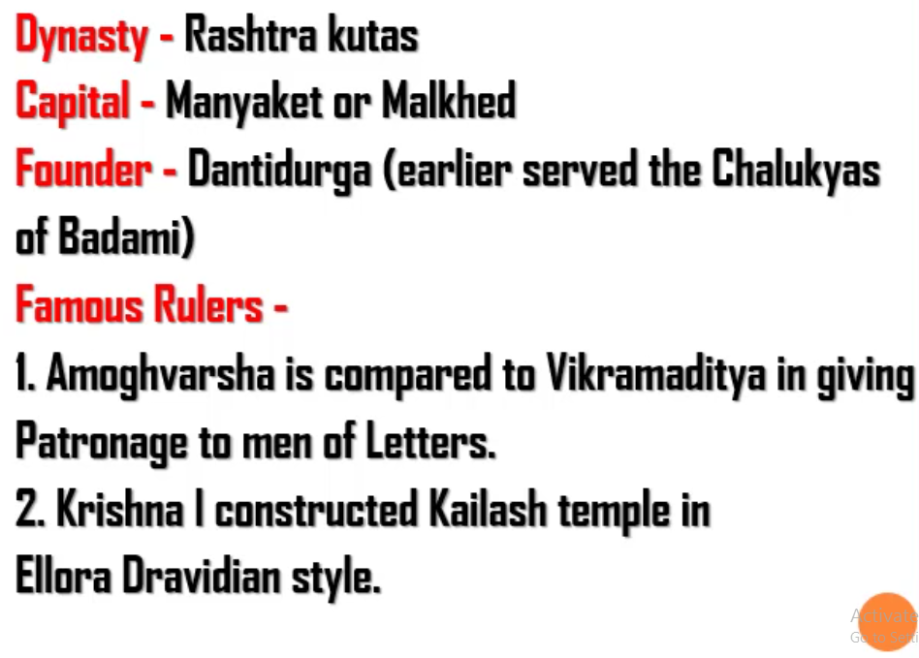
Chalukyas of Badami is also known as Chalukyas of Vatapi

Slide 7
